Slide 1



ATP-29
Jet Blue

Slide 2
Advanced Persistent Threat (ATP) 29
Threat Group
Affiliated with the Russian Government
Also known as: Cozy Bear, Office Monkeys, CozyCar and CozyDuke

Slide 3
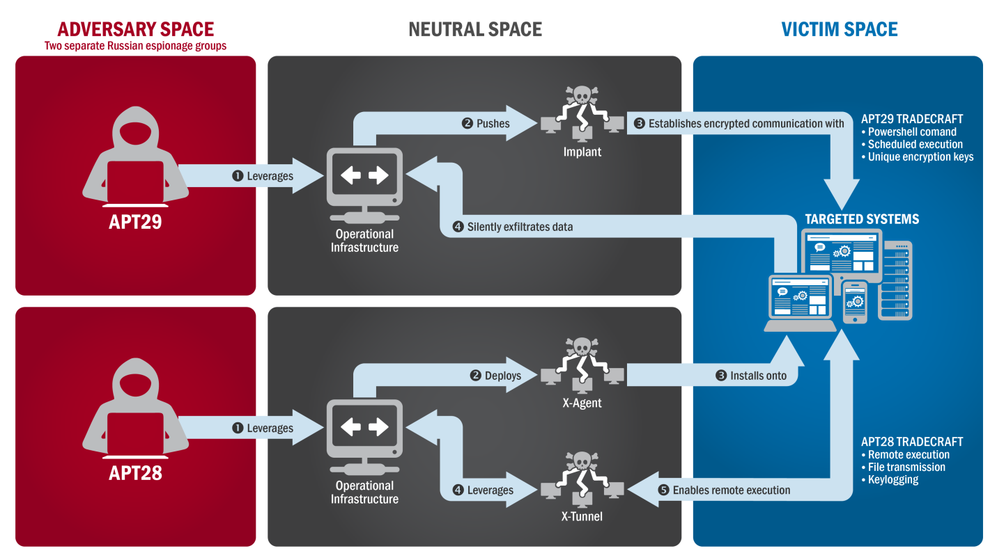
What Do They Do/How Do They Work?
Spear phishing and Malware
Use social media sites, such as Twitter and GitHub, as well as cloud services to obtain data and relay commands
Hide activity by posing as legitimate traffic on the victim’s network
Cycle the malware constantly to fight off those trying to counteract the malware
Deploy new backdoors to fix its own bugs and to update features

Slide 4
Impact and significance to date
Most recently in 2018, 20 organizations worldwide were targeted by the group.
Including: Think Tanks, Law Enforcement, Media, Military, Transportation, Pharmaceuticals, National Government and Defense Contracting.
High profile groups include the U.S. Pentagon in 2015, Democratic National Committee prior to the 2016 U.S. elections, and the U.S. Department of State Public Affairs in 2018.
Future impacts include organizations in the public and private sectors willingly and unknowingly providing information to unknown sources.
The attackers are sophisticated enough to go undetected for an extended period.
Attackers targeting political opponents and foreign governments can shape the future outcomes of those nations.

Slide 5
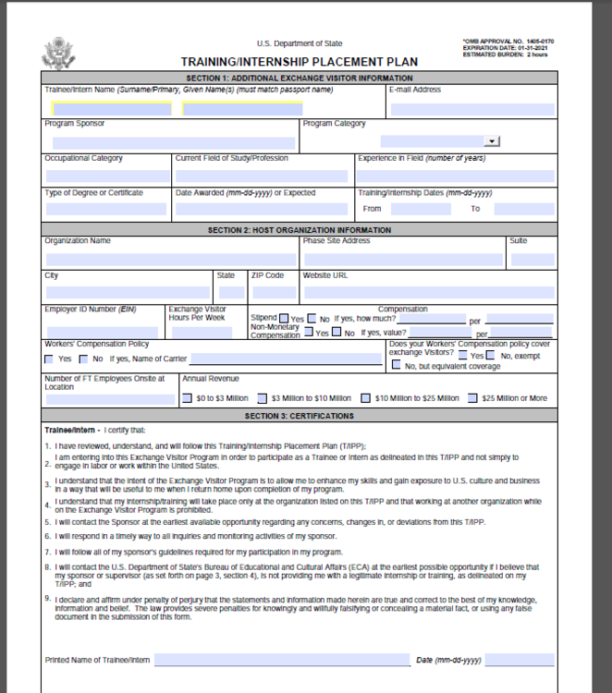
2018 U.S. State Department of Public Affairs
The phishing email contained an “official document” sent out by a “high ranking official” in the department.
The links led to a ZIP archive file which contained a weaponized Windows shortcut file which executed a PowerShell command.
The File then dropped a State Official public form and Cobalt Strike.

Slide 6
First identification of the threat
First identified in 2014
Used against a private research company in Washington D.C.
Employees throughout the company received an email of a link to a website containing a video of monkeys acting like human beings in an office setting.
Because the video was humorous, employees sent it to other employees throughout the company.
While the user was watching the video, the malware was installed into the system without any detection.
The undetected malware wasn’t discovered until months later and by that time the attackers gained access to government files.

Slide 7
What Steps should be Taken to mitigate risk in cases where users have already been affected
What steps can or should be taken to mitigate risk for future threats
Flag the email as a phishing email.
Notify others who also received the email.
Notify those in charge of the organization and the IT department.
Change your login credentials and passwords on the email used in the phishing scam and any other applications you use on the computer.
Apply email content filtering to identify malicious content.
Control which websites employees are permitted to access.
Keep operating systems up to date.
Encrypt all files on the device.
Add system controls to help stop the spread of malware.
Conduct employee training to help avoid future incidents.

Slide 8
Sources
FireEye: Advanced Persistent Threat Groups. FireEye, n.d. Web 23 Aug 2019
Dunwoody, Matthews, et al. FireEye: Not So Cozy: An Uncomfortable Examination of a Suspected APT29 Phishing Campaign. FireEye, 19 Nov 18. Web 23 Aug 2019
Barth, Bradley. SC Magazine: Cozy Bear Tracks: Phishing campaign looks like work of Russian APT group. SC Magazine, 19 Nov 18. Web 23 Aug 2019
Seals, Tara. Threatpost: APT29 Re-Emerges After 2 Years with Widespread Espionage Campaign. Threatpost, 20 Nov 18. Web 23 Aug 2019
CrowdStrike: Who Is Cozy Bear (APT 29)?. CrowdStrike, 19 Sept 16. Web 23 Aug 2019
The Guardian: US military’s joint staff hacked as officials point the finger at Russia. The Guardian, 06 Aug 15. Web 23 Aug 2019
Kaspersky: No Monkeys for CozyDuke. Kaspersky, 28 April 15. Web 23 Aug 2019
Cyware: Cozy Bear: Russian hacker group targeted 20 organizations across multiple countries. Cyware, 20 Nov 18. Web 23 Aug 2019

